Slide 1
Grab Cut Interactive Foreground extraction using iterated Graph Cuts
By, Carsten, Vladmir, Andrew

Slide 2
AGENDA
Introduction
Image Segmentation
Different Techniques for image segmentation
Graph Cut
Grab Cut

Slide 3
INTRODUCTION
Grab Cut is a technique to segment image. The segmentation is done such that we can have foreground and background separated. It provides an interactive foreground/background segmentation technique.

Slide 4
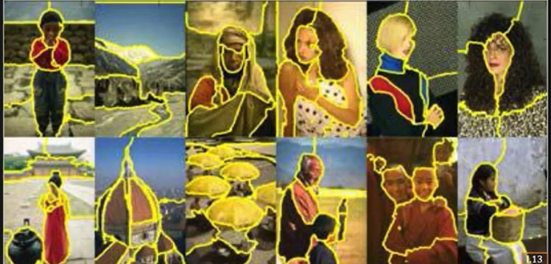
What’s Image segmentation? (And why it’s important)
Dividing an image into multiple distinct regions or segments based on the properties of the image.
Assign a label or group to each pixel in an image. This divides the image into different areas/segments.
​

Slide 5
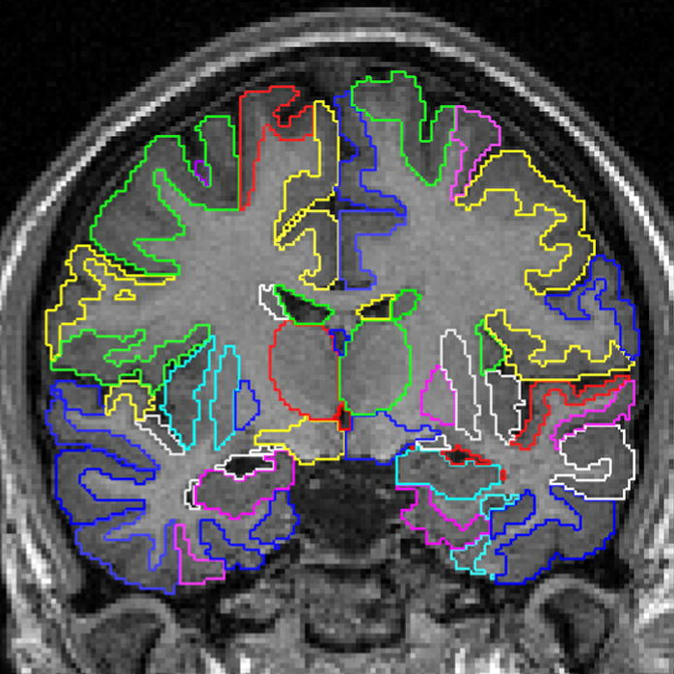
Why it’s important?
Object Recognition and Understanding: Image segmentation enables the identification and recognition of individual objects or regions within an image. By segmenting an image into distinct regions, it becomes easier to analyze and understand the content of the image.
Image Editing and Manipulation: In apps like Photoshop, by segmenting an image into different regions, specific editing operations can be applied selectively to individual objects or regions.
​
Medical Imaging Analysis: Image segmentation is widely used in medical imaging analysis, such as MRI, CT scans, and microscopy. Accurate segmentation helps in detecting tumors, measuring organ volumes, and tracking disease progression.
Video Analysis and Tracking: Image segmentation is not limited to static images but is also crucial in video analysis. By segmenting objects or regions across video frames, it becomes possible to track their motion, extract object trajectories, and analyze dynamic scenes.

Slide 6
Different techniques
(For foreground and background segmentation)

Slide 7
Segmentation Techniques
(Before Grabcut, these were the well-known techniques used)
Magic Wand
Intelligent Scissors
Bayes Cutting
Knockout 2
Graph Cut
​

Slide 8
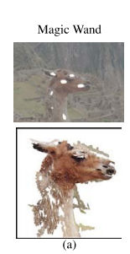
Magic Wand
Magic wand starts with a user defined pixel/region to compute region of connected pixels such that all the selected pixels fall within some adjustable tolerance of the color statistics of the specified region.
Finding the correct tolerance level is often cumbersome and difficult. As it varies with each image.

Slide 9
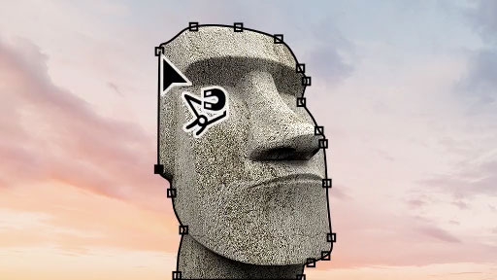
Intelligent Scissors (or Magnetic Lasso)
It allows user to choose a minimum cost contour by roughly tracing the object’s boundary with the mouse. As the mouse moves, the minimum cost path from the cursor positions back to the last ‘seed’ point.
The main limitation is if the image is highly textured/ or un-textured.

Slide 10
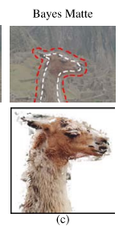
Bayes Matting
The user specifies a tri-map t = {T_{b}, T_{u}, T_{f}} in which background and foreground regions T_{b} and T_{f} are marked, and alphas value are computed over the remaining region T_{u}.
This method is effective only when T_{u} region is not too large and T_{b} and T_{f} are well separated.

Slide 11
Graph Cut

Slide 12
Graph Cut
Core Idea: Convert the image segmentation problem into a graph theoretical problem.
We convert the image into a graph and then cut the graph using some graph cutting criteria. This helps us to get the foreground and background separated.
Each pixel of the image is represented by a node in the graph, and each edge has weight which represents the similarity between the nodes/pixels.

Slide 13
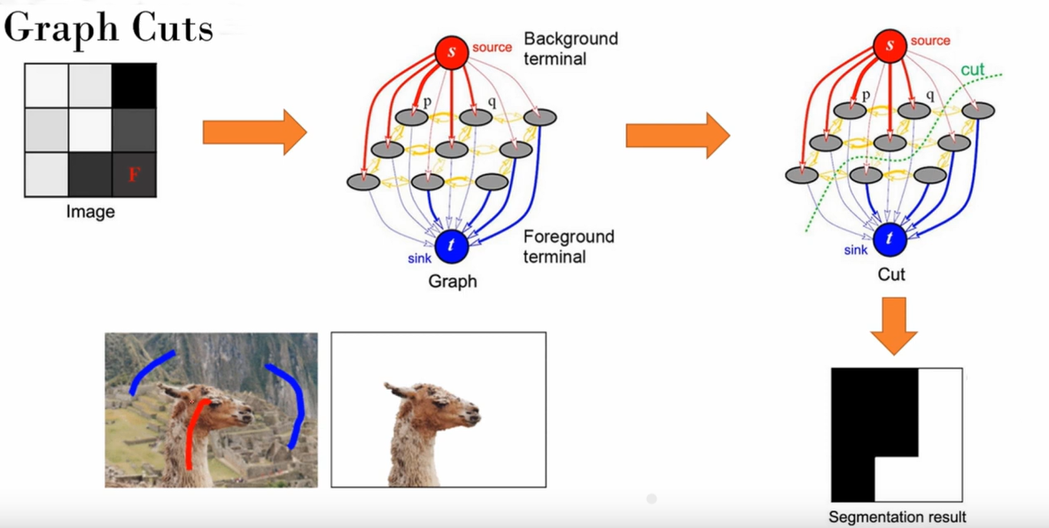
Graphical Representation

Slide 14
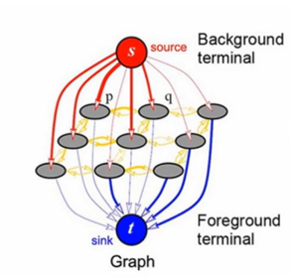
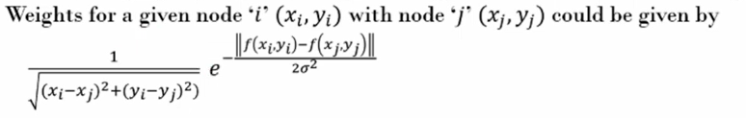
Weights
Interconnected Nodes Weights:
If the intensity of two pixels is almost same then the difference of f(x_{n}, y_{n}) becomes zero and we get e⁰ (=1).
And hence the more similar the nodes are, the more weight is between those nodes.

Slide 15
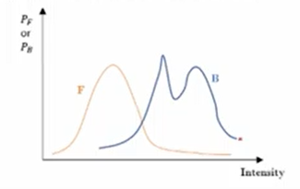
Weights
Super Nodes Weights:
Super nodes are the fore/background nodes marked by the user.

Slide 16
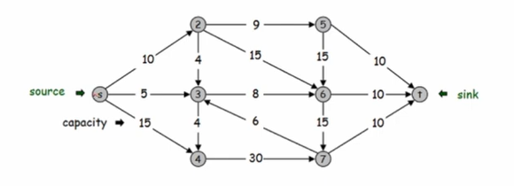
Graph

Slide 17
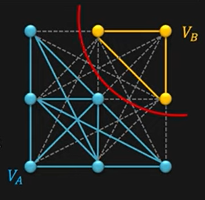
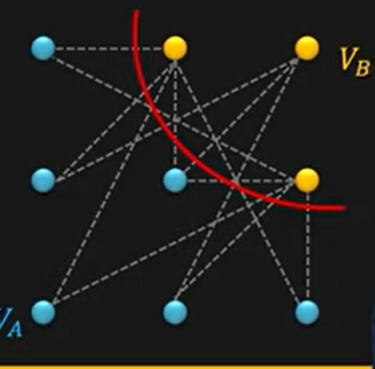
Graph Cut

Slide 18
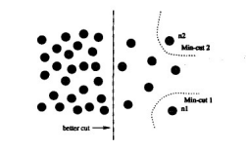
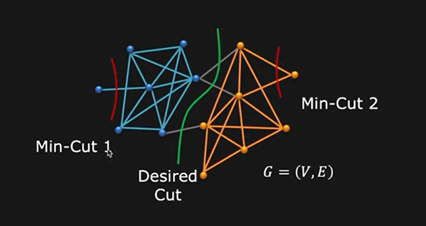
Min-CUt

Slide 19
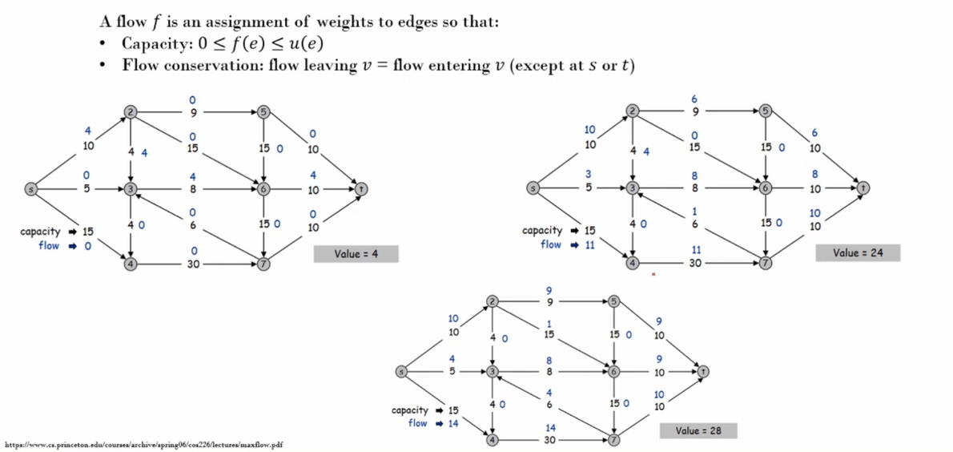
Max-Flow Min-Cut

Slide 20
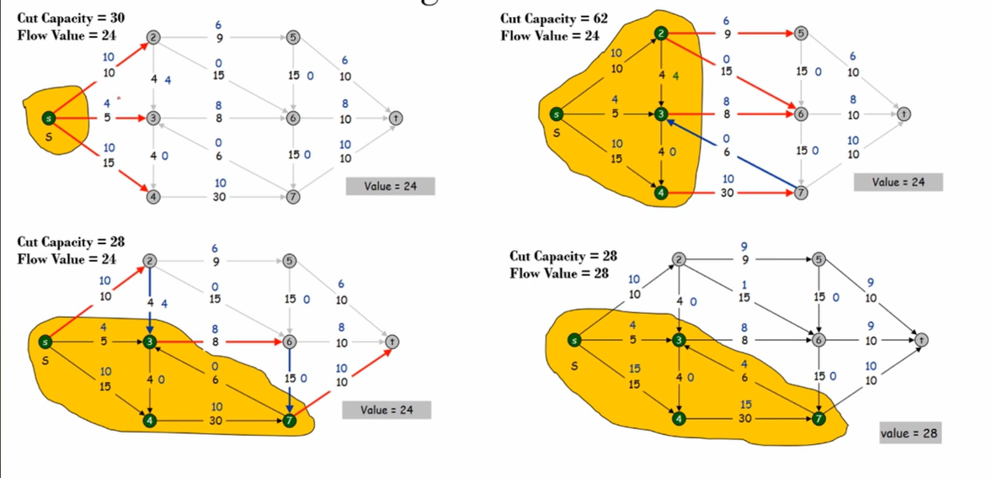
Max-Flow Min-Cut

Slide 21
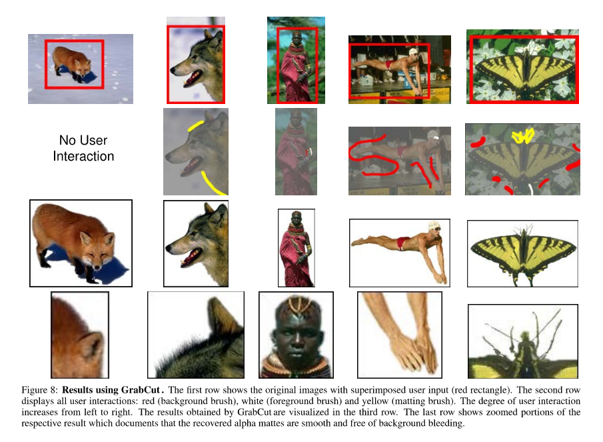
Grab Cut

Slide 22
References
BLAKE, A., ROTHER, C., BROWN, M., PEREZ, P., AND TORR, P. 2004. Interactive Image Segmentation using an adaptive GMMRF model. In Proc. European Conf Computer Vision.
BOYKOV, Y., AND JOLLY, M.-P. 2001. Interactive graph cuts for optimal boundary and region segmentation of objects in N-D images. In Proc. IEEE Int. Con:f on Computer Vision, CD-ROM.
BOYKOY, Y., AND KOLMOGOROY, V. 2003. Computing Geodesics and Minimal Surfaces via Graph Cut. In Proc. IEEE Int. Conf. on Computer Vision.
CASELLES, V., KIMMEL, R., AND SAPIRO, G. 1995. Geodesic active contours. In Proc. IEEE Int. Corif- on Computer Vision.
CHUANG, Y.-Y., CURLESS, B., SALES IN, D., AND SZELISKI, R. 2001. A Bayesian approach to digital matting. In Proc. IEEE Conj: Computer Vision and Pattern Recog., CD-ROM.
GREIG, D., PORTEOUS, B., AND SEHEULT, A. 1989. Exact MAP estimation for binary images. J. Roy. Stat. Soc. B. 51, 271-279.

Slide 23
THANK YOU
Harsh Sharma

